Slide 1

Java Programming
Threads

Slide 2
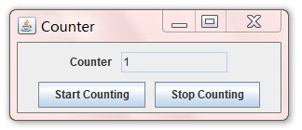
Unresponsive User Interface!
The infamous Unresponsive User Interface (UI) problem is best illustrated by the following Swing program with a counting-loop.

Slide 3
import java.awt.*;
import java.awt.event.*;
import javax.swing.*;
public class UnresponsiveUI extends JFrame {
private boolean stop = false;
private JTextField tfCount;
private int count = 1;
/** Constructor to setup the GUI components */
public UnresponsiveUIwThreadSleep() {
Container cp = getContentPane();
cp.setLayout(new FlowLayout(FlowLayout.CENTER, 10, 10));
cp.add(new JLabel("Counter"));
tfCount = new JTextField(count + "", 10);
tfCount.setEditable(false);
cp.add(tfCount);

Slide 4
JButton btnStart = new JButton("Start Counting");
cp.add(btnStart);
btnStart.addActionListener(new ActionListener() {
@Override
public void actionPerformed(ActionEvent evt) {
stop = false;
for (int i = 0; i < 100000; ++i) {
if (stop) break; // check if STOP button has been pushed,
// which changes the stop flag to true
tfCount.setText(count + "");
++count;
}
}
});
JButton btnStop = new JButton("Stop Counting");
cp.add(btnStop);
btnStop.addActionListener(new ActionListener() {
@Override
public void actionPerformed(ActionEvent evt) {
stop = true; // set the stop flag
}
});

Slide 5
setDefaultCloseOperation(JFrame.EXIT_ON_CLOSE);
setTitle("Counter");
setSize(300, 120);
setVisible(true);
}
/** The entry main method */
public static void main(String[] args) {
// Run GUI codes in Event-Dispatching thread for thread safety
javax.swing.SwingUtilities.invokeLater(new Runnable() {
@Override
public void run() {
new UnresponsiveUIwThreadSleep();
}
});
}
}

Slide 6
Outline
Unresponsive UI problem
Basic concepts
Concurrency
Processes and threads
Thread Object
Defining and Starting a Thread
The Life Cycle of a Thread
Solving Unresponsive UI problem
Synchronization
Counting game problem
Thread Scheduling and Priority
Solving Counting game problem
Collaboration of Threads

Slide 7
Concurrency
Computer users take it for granted that their systems can do more than one thing at a time.
Even a single application is often expected to do more than one thing at a time.
Software that can do such things is known as concurrent software.
Concurrency is useful to
Support GUI
improve performance

Slide 8
The Java platform is designed from the ground up to support concurrent programming.
In concurrent programming, there are two basic units of execution: processes and threads.

Slide 9
Processes
A process generally has a complete, private set of basic run-time resources; in particular, each process has its own memory space.
A computer system normally has many active processes and threads.
In systems that only have a single execution core, there is only one thread actually executing at any given moment.
Processing time for a single core is shared among processes and threads through an OS feature called time slicing.
Obviously, If your system has a multi-core CPU or many CPUs, multithreading is more efficient.

Slide 10
Threads
In the Java programming language, concurrent programming is mostly concerned with threads.
Threads are sometimes called lightweight processes. Both processes and threads provide an execution environment, but creating a new thread requires fewer resources than creating a new process.
Threads exist within a process, they share the process's resources, including memory and open files. This makes for efficient, but potentially problematic, communication.

Slide 11
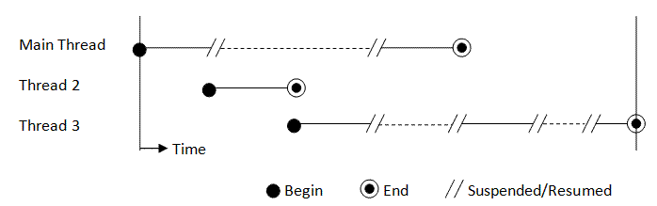
Threads
Every process has at least one thread, called the main thread.
The main thread has the ability to create additional threads.

Slide 12
Threads
Each thread is associated with an instance of the class Thread.
The class java.lang.Thread has the following constructors:
public Thread();
public Thread(String threadName);
public Thread(Runnable target);
public Thread(Runnable target, String threadName);

Slide 13
Threads
You can use following methods to get some attributes of a thread.
getId()
Returns the identifier of this Thread.
GetName()
Returns this thread's name.
getPriority()
Returns this thread's priority.

Slide 14
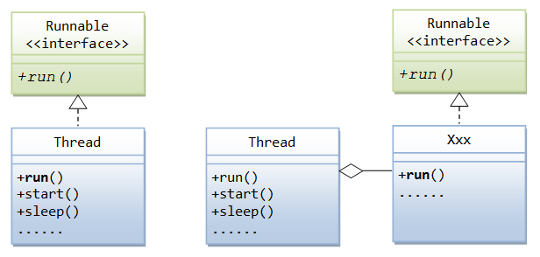
Defining a Thread
An application that creates an instance of Thread must provide the code that will run in that thread. There are two ways to do this:
Implement Runnable interface (recommend).
Subclass Thread.

Slide 15
Starting a Thread
As mentioned, the method run() specifies the running behavior of the thread.
If you want to start a thread, you do not invoke the run() method explicitly. Instead, you call the start() method of the class Thread.
The start() method allocates the system resources necessary to execute the thread, schedules the thread to be run, and calls back the run() once it is scheduled.
A thread cannot be started twice, which triggers a runtime IllegalThreadStateException.

Slide 16
Implementing Runnable interface
The Runnable interface defines a single method, run, meant to contain the code executed in the thread.
The Runnable object is passed to the Thread constructor, then invoke the Thread object’s start method to run the thread.

Slide 17
Implementing Runnable interface
public class HelloRunnable implements Runnable {
public void run() {
System.out.println("Hello from a new thread!");
}
public static void main(String args[]) {
(new Thread(new HelloRunnable())).start();
System.out.println(“Hello from the main thread!”);
}
}

Slide 18
What is the output?
public class HelloRunnable implements Runnable {
public void run() {
for(int i=0;i<1000;i++);
System.out.println("Hello from a new thread!");
}
public static void main(String args[]) {
(new Thread(new HelloRunnable())).start();
System.out.println(“Hello from the main thread!”);
}
}

Slide 19
Subclassing Thread
The Thread class itself implements Runnable, though its run method does nothing.
An application can subclass Thread, providing its own implementation of run.

Slide 20
Subclassing Thread
public class HelloThread extends Thread {
public void run() {
for(int i=0;i<1000;i++);
System.out.println("Hello from a new thread!");
}
public static void main(String args[]) {
(new HelloThread()).start();
System.out.println(“Hello from the main thread!”);
}
}

Slide 21
What is the output?
public class HelloThread extends Thread {
public void run() {
for(int i=0;i<1000;i++);
System.out.println("Hello from a new thread!");
}
public static void main(String args[]) {
Tread t = new HelloThread();
t.start();
t.join();
System.out.println(“Hello from the main thread!”);
}
}
The join() method Allows one thread to wait for the completion of another.

Slide 22
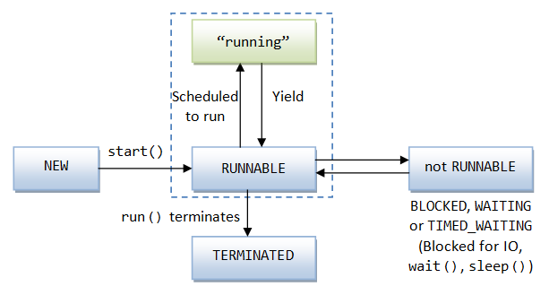
The Life Cycle of a Thread

Slide 23
The Life Cycle of a Thread
The start() method put the thread into the "runnable" state. in the "runnable" state, the thread may be running or waiting for its turn of the CPU time.
The thread enters the "not-runnable" state when one of these events occurs:
The sleep() method is called to suspend the thread for a specified amount of time to yield control to the other threads.
You can also invoke the yield() to hint to the scheduler that the current thread is willing to yield its current use of a processor. The scheduler is, however, free to ignore this hint.
The wait() method is called to wait for a specific condition to be satisfied.
The thread is blocked and waiting for an I/O operation to be completed.

Slide 24
The Life Cycle of a Thread
For the "non-runnable" state, the thread becomes "runnable" again:
If the thread was put to sleep, the specified sleep-time expired or the sleep was interrupted via a call to the interrupt() method.
If the thread was put to wait via wait(), its notify() or notifyAll() method was invoked to inform the waiting thread that the specified condition had been fulfilled and the wait was over.
If the thread was blocked for an I/O operation, the I/O operation has been completed.
A thread is in a "terminated" state, only when the run() method terminates naturally and exits.

Slide 25
Threads in Swing application
A Swing application runs on multiple threads. Specifically, It has three types of threads:
Initial thread, or the Main thread, which runs the main() method, starts the building of GUI, and exits.
The event dispatch thread, where all event-handling code is executed. Most code that interacts with the Swing framework must also execute on this thread.
Worker threads, also known as background threads, where time-consuming background tasks are executed.

Slide 26
Explanation for the unresponsive UI
The main() method is started in the "main" thread.
The JRE's windowing subsystem, via SwingUtilities.invokeLater(), starts the Event-Dispatching Thread (EDT).
You can also use java.awt.EventQueue.invokeLater() to start the EDT. javax.swing.SwingUtilities.invokeLater is just a cover for it.
When you click the START button, the actionPerformed() is run on the EDT.
The EDT is now fully-occupied with the compute-intensive counting-loop, and unable to process any event (e.g., clicking the STOP button or the window-close button) and refresh the display - until the counting completes and EDT becomes available.
As the result, the display freezes until the counting-loop completes.

Slide 27
Solving Unresponsive UI problem

Slide 28
JButton btnStart = new JButton("Start Counting");
cp.add(btnStart);
btnStart.addActionListener(new ActionListener() {
@Override
public void actionPerformed(ActionEvent evt) {
stop = false;
Thread t = new Thread(“Counting-Thread”) { // Create a new Thread to do the counting
@Override
public void run() {
for (int i = 0; i < 100000; ++i) {
if (stop) break;
tfCount.setText(count + "");
++count;
// Suspend this thread via sleep() and yield control to other threads.
try {
sleep(10); // milliseconds
} catch (InterruptedException ex) {}
}
}
};
t.start(); // call back run()
}
});

Slide 29
Explanation for the responsive GUI
In this case, the “Counting-Thread” thread created to do the counting yields control voluntarily to other threads after every count (via the "sleep(10)").
This allows the event-dispatching thread (EDT) to refresh the display as well as processing the "STOP" button after each count.
Note: In order to avoid unresponsive UI, the Time-consuming and blocking-IO tasks should not be run on the event-dispatching thread.

Slide 30

A Counting game in AppStore
Find Hidden Object
Assume that two players play the game together to find 50 hidden objects
Make a program to simulate the counting process

Slide 31
CountingGame
public class Counter {
private int count = 0;
public void count(String s) {
while(count<50){
count++;
System.out.println(s+":"+count);
}
}
}
public class CounterPlayer extends Thread {
private Counter c;
public CounterPlayer (Counter c) {
this.c = c;
}
public void run() {
c.count(this.name);
}
}

Slide 32
What is the output?
public class CountingGame{
public static void main(String[] args) {
Counter c = new Counter();
CounterPlayer player1 = new CounterPlayer(c);
CounterPlayer player2 = new CounterPlayer(c);
player1.start();
player2.start();
}
}

Slide 33
Why error?
The fundamental problem in the previous program was that there were two threads modifying the fields of the same object.
Furthermore the order in which the fields were modified is indeterminate.

Slide 34
Thread Scheduling and Priority
JVM implements a fixed priority thread-scheduling scheme. Each thread is assigned a priority number (between the Thread.MIN_PRIORITY and Thread.MAX_PRIORITY).
When a new thread is created, it inherits the priority number from the thread that created it.
You can used the method setPriority() to change the priority number of a thread.

Slide 35
Thread Scheduling and Priority
JVM implements a preemptive scheduling scheme. In a preemptive environment, if at any time a higher priority thread becomes "runnable", the current lower priority thread will yield control to the higher priority thread immediately.
If there is more than one thread with the same highest-priority, JVM schedules them in a round-robin manner.

Slide 36
Thread Scheduling and Priority
If there are more than one equal-priority runnable threads, one thread may run until the completion without yielding control to other equal-priority threads. This is known as starvation.
In some operating systems such as Windows, each of the running thread is given a specific amount of CPU time. It is known as time slicing to prevent a thread from starving the other equal-priority threads. However, do not rely on time slicing, as it is implementation dependent.

Slide 37
Thread Scheduling and Priority
A running thread will continue running until:
A higher priority thread becomes "runnable".
The running thread yields control voluntarily by calling methods such as sleep(), yield(), and wait().
The running thread terminates, i.e., its run() method exits.
On system that implements time slicing, the running thread consumes its CPU time quota.

Slide 38
Thread Scheduling and Priority
Note:
JVM requires the native operating system resources to support multithreading.
Most JVM does not guarantee that the highest-priority thread is being run at all times. It may choose to dispatch a lower-priority thread for some reasons such as to prevent starvation. Therefore, you should not rely on the priority in your algorithm.

Slide 39
Solving the Counting game problem
There are a number of possible solutions to this problem.
Immutable object
one of the simplest and most direct is to make the object immutable; that is, not to allow it to change after it's been constructed.
Synchronization
Java does allow you to guarantee that no more than one thread at a time will run a method. Other threads will have to wait for the first thread to finish running. In the meantime they block, that is stop executing.
Note: Not all solutions are valid in all situations

Slide 40
Solving the Counting game problem
Each Java object has a lock (also called monitor). At any time, the lock is controlled by, at most, a single thread.
multithreading is built into the Java language right at the root class java.lang.Object. The synchronization lock is kept in the Object.
You could mark a method or a block of the codes with keyword synchronized.

Slide 41
Solving the Counting game problem
A thread that wants to execute an object's synchronized code must first attempt to acquire its lock.
When a thread that owns a lock completes the synchronized code, it gives up the lock.
If the lock is under the control of another thread, then the attempting thread goes into the Seeking Lock state and becomes ready only when the lock becomes available.
Synchronization can be controlled at method level or block level.

Slide 42
Synchronized methods
You can use the synchronized keyword on a method. That is to say the synchronization will be controlled at method level.
This guarantees that no more than one thread at a time will run a method. Other threads will have to wait for the first thread to finish running.
Note:
In general, synchronized methods run three to ten times slower that the equivalent non-synchronized method.
Since there's only one lock per object, it's not just the synchronized method that can't be invoked by other threads. It's any other synchronized method or block of code in that object.

Slide 43
Solving the Counting game problem
public class Counter {
private int count = 0;
public synchronized void count(String s) {
while(count<50){
count++;
System.out.println(s+":"+count);
}
}
}

Slide 44
Synchronized blocks
You can synchronize at a lower level than a method.
That is to say you can synchronize lines of code in a method.
Syntax:
synchronized (this) {
//lines of codes will be synchronized
…
}

Slide 45
Solving the Counting game problem
public class Counter {
private int count = 0;
public void count(String s) {
while(count<50){
synchronized(this){
count++;
System.out.println(s+":"+count);
}
}
}
}

Slide 46
Solving the Counting game problem
public class Counter {
private int count = 0;
public void count(String s) {
while(count<50){
synchronized(this){
count++;
System.out.println(s+":"+count);
}
try {
Thread.sleep(5);
} catch (InterruptedException e) {
e.printStackTrace();
}
}
}
}

Slide 47
Synchronized on other object
We can synchronize on other objects too.
public static void bubbleSort(int[] n) {
boolean sorted = false;
synchronized(n) {
//codes for bubble sorting on array n
…
} // end synchronized
}
Note: we cannot synchronize primitive data types like int, float, or char.

Slide 48
Lifecycle of Thread (continued)

Slide 49
States of a thread
A thread can be in one of the following states:
NEW
A thread that has not yet started is in this state.
RUNNABLE
A thread executing in the Java virtual machine is in this state.
BLOCKED
A thread that is blocked waiting for a monitor lock is in this state.
WAITING
A thread that is waiting indefinitely for another thread to perform a particular action is in this state.
TIMED_WAITING
A thread that is waiting for another thread to perform an action for up to a specified waiting time is in this state.
TERMINATED
A thread that has exited is in this state.

Slide 50
Methods about thread states
The isAlive() method
The isAlive() returns false if the thread is "new" or "terminated".
It returns true if the thread is "runnable" or "not-runnable".
The getState() method
This method returns an (nested) enum of type Thread.State, which takes a constant of {NEW, BLOCKED, RUNNABLE, TERMINATED, WAITING, TIMED_WAITING}.

Slide 51
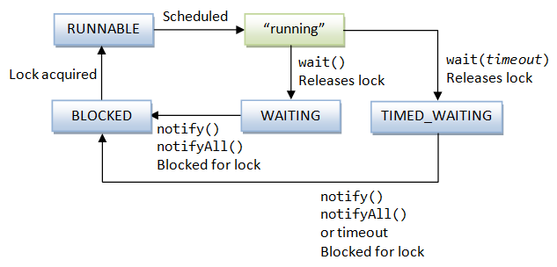
Lifecycle of Thread (continued)

Slide 52
Collaboration of Threads
To enable collaboration of different threads, Java provides following methods.
x.wait() tells the calling thread to give up the monitor of object x and go to sleep until some other thread enters the same monitor and calls notify().
x.notify() wakes up the first thread that called wait() on the same object x.
x.notifyAll() awakens all the threads in object x's waiting thread pool.
Note:
wait(), notify(), notifyAll() must be invoked in the synchronized block, otherwise JVM will throw java.lang.IllegalMonitorStateException.

Slide 53
What is the output?
public class ThreadA {
public static void main(String[] args) {
ThreadB b = new ThreadB();
b.start();
System.out.println("Total is: " + b.total);
}
}
class ThreadB extends Thread {
int total;
@Override
public void run() {
for (int i = 0; i < 100; i++) {
total += i;
}
}
}

Slide 54
What is the output?
public class ThreadA {
public static void main(String[] args){
ThreadB b = new ThreadB();
b.start();
synchronized(b){
try{
System.out.println("Waiting for b to complete...");
b.wait();
}catch(InterruptedException e){
e.printStackTrace();
}
System.out.println("Total is: " + b.total);
}
}
}
class ThreadB extends Thread{
int total;
@Override
public void run(){
synchronized(this){
for(int i=0; i<100 ; i++){
total += i;
}
notify();
}
}
}

Slide 55
Avoiding Deadlock
What is Deadlock?
Two threads can each lock an object the other needs, and thus prevent both threads from running.
We must avoid deadlock.
Synchronization is a dangerous thing and should be avoided where possible.

Slide 56
Interrupts
An interrupt is an indication to a thread that it should stop what it is doing and do something else.
It's up to the programmer to decide exactly how a thread responds to an interrupt, but it is very common for the thread to terminate.
The interrupt mechanism is implemented using an internal flag known as the interrupt status.
Invoking Thread.interrupt sets this flag.
When a thread checks for an interrupt by invoking the static method Thread.interrupted, interrupt status is cleared.
By convention, any method that exits by throwing an InterruptedException clears interrupt status when it does so.
Notes:
The non-static isInterrupted method, which is used by one thread to query the interrupt status of another, does not change the interrupt status flag.

Slide 57
Interrupts
How does a thread support its own interruption? This depends on what it's currently doing.
If the thread is frequently invoking methods (for example, the sleep method) that throw InterruptedException, it simply returns from the run method after it catches that exception.
If a thread goes a long time without invoking a method that throws InterruptedException, then it must periodically invoke Thread.interrupted, which returns true if an interrupt has been received.

Slide 58
By throwing InterruptedException
for (int i = 0; i < importantInfo.length; i++) {
// Pause for 4 seconds
try {
Thread.sleep(4000);
} catch (InterruptedException e) {
// We've been interrupted: no more messages.
return;
}
// Print a message
System.out.println(importantInfo[i]);
}

Slide 59
By invoking Thread.interrupted
for (int i = 0; i < inputs.length; i++) {
heavyCrunch(inputs[i]);// a long time task
if (Thread.interrupted()) {
// We've been interrupted: no more crunching.
return;
//throw new InterruptedException(); if needed
}
}

Slide 60
Notice
In almost all cases multi-threading also make debugging, testing, and maintenance vastly more difficult and sometimes impossible.
Think twice about using threads in cases where they are not absolutely necessary.

Slide 61
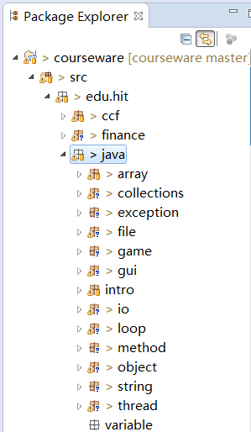
Counting lines of code
We classify lines of code into three types:
White lines
Comment lines
Normal lines
We are going to count the three types of the LOCs respectively for all the java source files in the workspace of Eclipse.

Slide 62
Multithreading LOC Counter
We have had LineCounter.java to process all the java source files in one thread, can we processing these files concurrently? And is it more efficient?

Slide 63


